Slide 1
CH03 User Authentication
Zonghua Gu
2017, ZJU
Notes:
This chapter provides an overview of computer security. We begin with a discussion
of what we mean by computer security. In essence, computer security deals
with computer-related assets that are subject to a variety of threats and for which
various measures are taken to protect those assets. Accordingly, the next section of
this chapter provides a brief overview of the categories of computer-related assets
that users and system managers wish to preserve and protect, and a look at the
various threats and attacks that can be made on those assets. Then, we survey the
measures that can be taken to deal with such threats and attacks. This we do from
three different viewpoints, in Sections 1.3 through 1.5. We then lay out in general
terms a computer security strategy.
The focus of this chapter, and indeed this book, is on three fundamental
questions:
1. What assets do we need to protect?
2. How are those assets threatened?
3. What can we do to counter those threats?

Slide 2
Outline
Introduction
Password-based authentication
Token-based authentication
Biometric authentication
Remote user authentication

Slide 3
User Authentication
NIST definition: “The process of establishing confidence in user identities that are presented electronically to an information system.”
It is the fundamental building block and first line of defense, and the basis for access control and user accountability.
Notes:
An authentication process consists of two steps:
Identification step: Presenting an identifier to the security system. (Identifiers
should be assigned carefully, because authenticated identities are the basis for
other security services, such as access control service.)
Verification step: Presenting or generating authentication information that
corroborates the binding between the entity and the identifier.
For example, user Alice Toklas could have the user identifier ABTOKLAS. This
information needs to be stored on any server or computer system that Alice wishes
to use and could be known to system administrators and other users. A typical item
of authentication information associated with this user ID is a password, which is
kept secret (known only to Alice and to the system). If no one is able to obtain or
guess Alice’s password, then the combination of Alice’s user ID and password enables
administrators to set up Alice’s access permissions and audit her activity. Because
Alice’s ID is not secret, system users can send her e-mail, but because her password is
secret, no one can pretend to be Alice.
In essence, identification is the means by which a user provides a claimed identity
to the system; user authentication is the means of establishing the validity of the claim.
Note that user authentication is distinct from message authentication. As defined in
Chapter 2, message authentication is a procedure that allows communicating parties
to verify that the contents of a received message have not been altered and that the
source is authentic. This chapter is concerned solely with user authentication.

Slide 4
Four Means of Authentication
Something the individual knows
Password, PIN, answers to prearranged questions
Something the individual possesses (token)
Smartcard, electronic keycard, physical key
Something the individual is (static biometrics)
Fingerprint, retina, face
Something the individual does (dynamic biometrics)
Voice pattern, handwriting, typing rhythm, modern face recognition
Notes:
There are four general means of authenticating a user's identity, which can be used alone or in combination:
• Something the individual knows: Examples includes a password, a personal identification number (PIN), or answers to a prearranged set of questions.
• Something the individual possesses: Examples include electronic keycards, smart cards, and physical keys. This type of authenticator is referred to as a token.
• Something the individual is (static biometrics): Examples include recognition by fingerprint, retina, and face.
• Something the individual does (dynamic biometrics): Examples include recognition by voice pattern, handwriting characteristics, and typing rhythm.
All of these methods, properly implemented and used, can provide secure user authentication. However, each method has problems. An adversary may be able to guess or steal a password. Similarly, an adversary may be able to forge or steal a token. A user may forget a password or lose a token. Further, there is a significant administrative overhead for managing password and token information on systems and securing such information on systems. With respect to biometric authenticators, there are a variety of problems, including dealing with false positives and false negatives, user acceptance, cost, and convenience.

Slide 5
Multifactor Authentication
Uses multiple methods (factors) in combination
Bank card in combination with a PIN
Finger print in combination with a PIN
Password in combination with a code via SMS to your mobile phone (验证码)
May be triggered by unusual activities
e.g., if system detects (via IP address or GPS) that you are not at your usual location, then use multi-factor authentication
Notes:
Uses multiple methods (factors) in combination
AMT card in combination with a PIN
Finger print in combination with a PIN
Password in combination with a code via SMS to your phone (验证码)
May be triggered by unusual activities
e.g., if system detects (via IP address or GPS) that you are not at your usual location, then use multi-factor authentication

Slide 6
Risk Assessment for User Authentication
Potential impact
Three levels of potential impact on organizations or individuals should there be a breach of security: low, moderate, high.
Assurance Level determined by potential impact
Describes an organization’s degree of certainty that a user has presented a credential that refers to his or her identity.
e.g., If the potential impact is low, an assurance level of 1 is adequate; if the potential impact is high, an assurance level of 4 is needed.
Notes:
Risk Assessment for User Authentication

Slide 7
Outline
Introduction
Password-based authentication
Token-based authentication
Biometric authentication
Remote user authentication

Slide 8
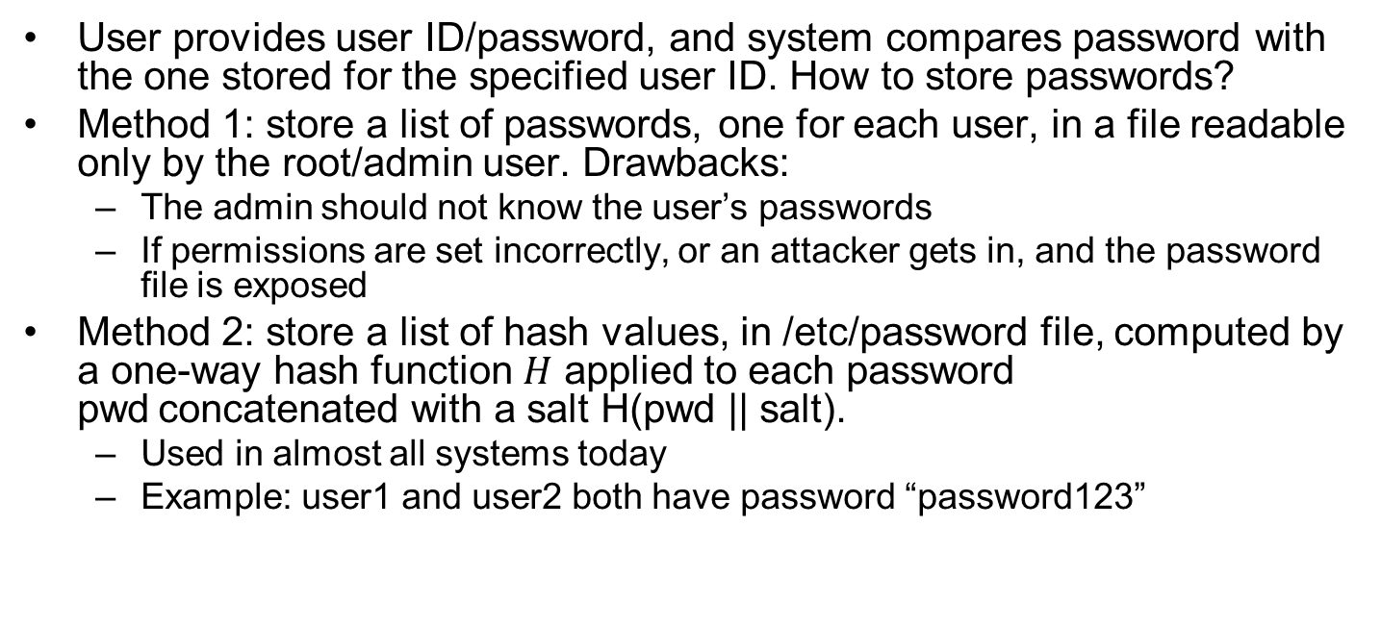
Password Authentication
User provides user ID/password, and system compares password with the one stored for the specified user ID. How to store passwords?
Method 1: store a list of passwords, one for each user, in a file readable only by the root/admin user. Drawbacks:
The admin should not know the user’s passwords
If permissions are set incorrectly, or an attacker gets in, and the password file is exposed
Method 2: store a list of hash values, in /etc/password file, computed by a one-way hash function $H$ applied to each password pwd concatenated with a salt H(pwd || salt).
Used in almost all systems today
Example: user1 and user2 both have password “password123”
Username | Salt value | String to be hashed | Hashed value = SHA256 (Salt value + Password)
user1 | E1F53135E559C253 | password123E1F53135E559C253 | 72AE25495A7981C40622D49F9A52E4F1565C90F048F59027BD9C8C8900D5C3D8
user2 | 84B03D034B409D4E | password12384B03D034B409D4E | B4B6603ABC670967E99C7E7F1389E40CD16E78AD38EB1468EC2AA1E62B8BED3A
Notes:
The Password and salt (a random number generated when password is set) are used as input to a hash function to produce a hash value.

Slide 9
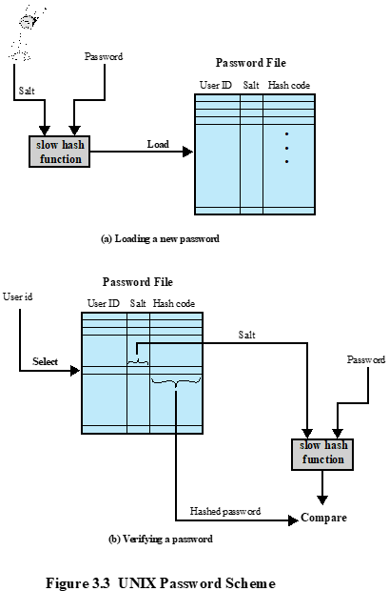
The UNIX Password Scheme
When user Bob creates a new account or sets a new password, his user ID Bob, the salt and the hash value H(pwd[Bob] || salt[Bob]) are stored in /etc/password file.
When Bob attempts to log in, he enters his user ID Bob and Password. The system uses the user ID Bob to retrieve salt[Bob], and computes H(Password || salt[Bob]). If the result matches the stored value H(pwd[Bob] || salt[Bob]), then Bob is authenticated.
The hashing algorithm is designed to be relatively slow to make it difficult for the attacker to try many passwords, but not perceptible to a legitimate user who logins.
Notes:
Passwords chosen by humans often have regularities, but the salt is a random number.
A widely used password security technique is the use of hashed passwords and
a salt value. This scheme is found on virtually all UNIX variants as well as on
a number of other operating systems. The following procedure is employed
(Figure 3.2a). To load a new password into the system, the user selects or is
assigned a password. This password is combined with a fixed-length salt
value [MORR79]. In older implementations, this value is related to the time
at which the password is assigned to the user. Newer implementations use a
pseudorandom or random number. The password and salt serve as inputs to a
hashing algorithm to produce a fixed-length hash code. The hash algorithm is
designed to be slow to execute in order to thwart attacks. The hashed password
is then stored, together with a plaintext copy of the salt, in the password file for
the corresponding user ID. The hashed password method has been shown to be
secure against a variety of cryptanalytic attacks [WAGN00].
When a user attempts to log on to a UNIX system, the user provides an ID
and a password (Figure 3.2b). The operating system uses the ID to index into the
password file and retrieve the plaintext salt and the encrypted password. The salt
and user-supplied password are used as input to the encryption routine. If the result
matches the stored value, the password is accepted.
The salt serves three purposes:
• It prevents duplicate passwords from being visible in the password file. Even if
two users choose the same password, those passwords will be assigned different
salt values. Hence, the hashed passwords of the two users will differ.
• It greatly increases the difficulty of offline dictionary attacks. For a salt of
length b bits, the number of possible passwords is increased by a factor of 2^{b},
increasing the difficulty of guessing a password in a dictionary attack.
• It becomes nearly impossible to find out whether a person with passwords on
two or more systems has used the same password on all of them.
To see the second point, consider the way that an offline dictionary attack
would work. The attacker obtains a copy of the password file. Suppose first that
the salt is not used. The attacker’s goal is to guess a single password. To that end,
the attacker submits a large number of likely passwords to the hashing function.
If any of the guesses matches one of the hashes in the file, then the attacker
has found a password that is in the file. But faced with the UNIX scheme, the
attacker must take each guess and submit it to the hash function once for each
salt value in the dictionary file, multiplying the number of guesses that must be
checked.
There are two threats to the UNIX password scheme. First, a user can gain
access on a machine using a guest account or by some other means and then run
a password guessing program, called a password cracker, on that machine. The
attacker should be able to check many thousands of possible passwords with little
resource consumption. In addition, if an opponent is able to obtain a copy of the
password file, then a cracker program can be run on another machine at leisure. This
enables the opponent to run through millions of possible passwords in a reasonable
period.

Slide 10
Password Cracking
Dictionary attacks
Develop a large dictionary of possible passwords and try each against the password file
Numerous leaked plaintext passwords are available online.
Each password is hashed using each user’s salt value, and then compared to his stored hash value in the password file.
Try popular passwords first.
Rainbow table attacks
To trade off space for time, attacker pre-computes a huge tables of hash values for all password/salt combinations, to avoid computing hash values during attack.
Notes:
Complex password policy
Forcing users to pick stronger passwords
Sadly, this type of vulnerability has not lessened in
the past 25 years or so. Users are doing a better job of selecting passwords, and
organizations are doing a better job of forcing users to pick stronger passwords, a
concept known as a complex password policy, as discussed subsequently. However,
password-cracking techniques have improved to keep pace. The improvements
are of two kinds. First, the processing capacity available for password cracking has
increased dramatically. Now used increasingly for computing, graphics processors
allow password-cracking programs to work thousands of times faster than they did
just a decade ago on similarly priced PCs that used traditional CPUs alone. A PC
running a single AMD Radeon HD7970 GPU, for instance, can try on average an
8.2 * 10⁹ password combinations each second, depending on the algorithm used
to scramble them [GOOD12a]. Only a decade ago, such speeds were possible only
when using pricey supercomputers.
The second area of improvement in password cracking is in the use of sophisticated
algorithms to generate potential passwords. For example, [NARA05] developed
a model for password generation using the probabilities of letters in natural language.
The researchers used standard Markov modeling techniques from natural language
processing to dramatically reduce the size of the password space to be searched.
But the best results have been achieved by studying examples of actual passwords
in use. To develop techniques that are more efficient and effective than simple
dictionary and brute-force attacks, researchers and hackers have studied the
structure of passwords. To do this, analysts need a large pool of real-word passwords
to study, which they now have. The first big breakthrough came in late 2009,
when an SQL injection attack against online games service RockYou.com exposed
32 million plaintext passwords used by its members to log in to their accounts
[TIMM10]. Since then, numerous sets of leaked password files have become available
for analysis.
Trade off space for time by precomputing a huge table of potential hash values
Each given password for each possible salt value.
Using large datasets of leaked passwords as training data, [WEIR09] reports
on the development of a probabilistic context-free grammar for password cracking.
In this approach, guesses are ordered according to their likelihood, based on
the frequency of their character-class structures in the training data, as well as the
frequency of their digit and symbol substrings. This approach has been shown to be
efficient in password cracking [KELL12, ZHAN10].
6 random upper-case/lower-case/digits have $6^{26}$ possible passwords, which can be all tried by the GPU in a few minutes.
Can be countered by using longer password length
Can be countered by using a sufficiently large salt value and/or hash length

Slide 11
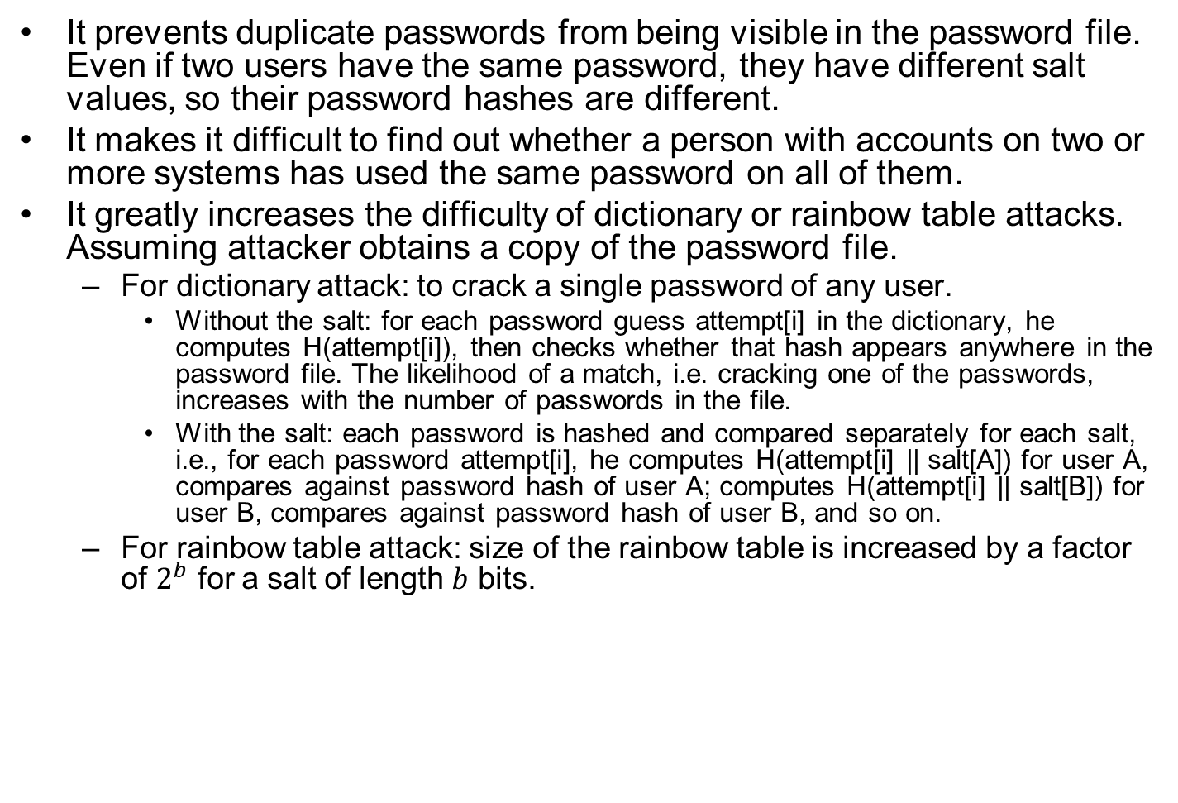
Purpose of the Salt
It prevents duplicate passwords from being visible in the password file. Even if two users have the same password, they have different salt values, so their password hashes are different.
It makes it difficult to find out whether a person with accounts on two or more systems has used the same password on all of them.
It greatly increases the difficulty of dictionary or rainbow table attacks. Assuming attacker obtains a copy of the password file.
For dictionary attack: to crack a single password of any user.
Without the salt: for each password guess attempt[i] in the dictionary, he computes H(attempt[i]), then checks whether that hash appears anywhere in the password file. The likelihood of a match, i.e. cracking one of the passwords, increases with the number of passwords in the file.
With the salt: each password is hashed and compared separately for each salt, i.e., for each password attempt[i], he computes H(attempt[i] || salt[A]) for user A, compares against password hash of user A; computes H(attempt[i] || salt[B]) for user B, compares against password hash of user B, and so on.
For rainbow table attack: size of the rainbow table is increased by a factor of $2^{b}$ for a salt of length $b$ bits.
Notes:
A widely used password security technique is the use of hashed passwords and
a salt value. This scheme is found on virtually all UNIX variants as well as on
a number of other operating systems. The following procedure is employed
(Figure 3.2a). To load a new password into the system, the user selects or is
assigned a password. This password is combined with a fixed-length salt
value [MORR79]. In older implementations, this value is related to the time
at which the password is assigned to the user. Newer implementations use a
pseudorandom or random number. The password and salt serve as inputs to a
hashing algorithm to produce a fixed-length hash code. The hash algorithm is
designed to be slow to execute in order to thwart attacks. The hashed password
is then stored, together with a plaintext copy of the salt, in the password file for
the corresponding user ID. The hashed password method has been shown to be
secure against a variety of cryptanalytic attacks [WAGN00].
When a user attempts to log on to a UNIX system, the user provides an ID
and a password (Figure 3.2b). The operating system uses the ID to index into the
password file and retrieve the plaintext salt and the encrypted password. The salt
and user-supplied password are used as input to the encryption routine. If the result
matches the stored value, the password is accepted.
The salt serves three purposes:
• It prevents duplicate passwords from being visible in the password file. Even if
two users choose the same password, those passwords will be assigned different
salt values. Hence, the hashed passwords of the two users will differ.
• It greatly increases the difficulty of offline dictionary attacks. For a salt of
length b bits, the number of possible passwords is increased by a factor of 2^{b},
increasing the difficulty of guessing a password in a dictionary attack.
• It becomes nearly impossible to find out whether a person with passwords on
two or more systems has used the same password on all of them.
To see the second point, consider the way that an offline dictionary attack
would work. The attacker obtains a copy of the password file. Suppose first that
the salt is not used. The attacker’s goal is to guess a single password. To that end,
the attacker submits a large number of likely passwords to the hashing function.
If any of the guesses matches one of the hashes in the file, then the attacker
has found a password that is in the file. But faced with the UNIX scheme, the
attacker must take each guess and submit it to the hash function once for each
salt value in the dictionary file, multiplying the number of guesses that must be
checked.
There are two threats to the UNIX password scheme. First, a user can gain
access on a machine using a guest account or by some other means and then run
a password guessing program, called a password cracker, on that machine. The
attacker should be able to check many thousands of possible passwords with little
resource consumption. In addition, if an opponent is able to obtain a copy of the
password file, then a cracker program can be run on another machine at leisure. This
enables the opponent to run through millions of possible passwords in a reasonable
period.

Slide 12
Salt Quiz
Q: Assuming attacker obtains a copy of the password file, and he wants to use dictionary attack to crack the password of a specific user Bob. Does the salt increase the difficulty of this attack?
ANS: No.
For each password guess attempt[i] in the dictionary, he computes H(attempt[i] || salt[Bob]) for a single salt[Bob], then compares it to Bob’s stored hash value in the password file. Computing the hash adds a little computation delay, but it is not significant.
The salt greatly increases difficulty of cracking password for any user in the password file with dictionary or rainbow table attack, which is more likely to find a match than cracking the password of any specific user.

Slide 13
The Hash Function
Recommended hash function is based on MD5
Password length is unlimited
Uses 48-bit salt to create 128-bit hash value
Uses an inner loop with 1000 iterations to achieve slowdown
OpenBSD uses Blowfish block cipher based hash algorithm called Bcrypt
Most secure version of Unix hash/salt scheme
Uses 128-bit salt to create 192-bit hash value
Notes:
A widely used password security technique is the use of hashed passwords and
a salt value. This scheme is found on virtually all UNIX variants as well as on
a number of other operating systems. The following procedure is employed
(Figure 3.2a). To load a new password into the system, the user selects or is
assigned a password. This password is combined with a fixed-length salt
value [MORR79]. In older implementations, this value is related to the time
at which the password is assigned to the user. Newer implementations use a
pseudorandom or random number. The password and salt serve as inputs to a
hashing algorithm to produce a fixed-length hash code. The hash algorithm is
designed to be slow to execute in order to thwart attacks. The hashed password
is then stored, together with a plaintext copy of the salt, in the password file for
the corresponding user ID. The hashed password method has been shown to be
secure against a variety of cryptanalytic attacks [WAGN00].
When a user attempts to log on to a UNIX system, the user provides an ID
and a password (Figure 3.2b). The operating system uses the ID to index into the
password file and retrieve the plaintext salt and the encrypted password. The salt
and user-supplied password are used as input to the encryption routine. If the result
matches the stored value, the password is accepted.
The salt serves three purposes:
• It prevents duplicate passwords from being visible in the password file. Even if
two users choose the same password, those passwords will be assigned different
salt values. Hence, the hashed passwords of the two users will differ.
• It greatly increases the difficulty of offline dictionary attacks. For a salt of
length b bits, the number of possible passwords is increased by a factor of 2^{b},
increasing the difficulty of guessing a password in a dictionary attack.
• It becomes nearly impossible to find out whether a person with passwords on
two or more systems has used the same password on all of them.
To see the second point, consider the way that an offline dictionary attack
would work. The attacker obtains a copy of the password file. Suppose first that
the salt is not used. The attacker’s goal is to guess a single password. To that end,
the attacker submits a large number of likely passwords to the hashing function.
If any of the guesses matches one of the hashes in the file, then the attacker
has found a password that is in the file. But faced with the UNIX scheme, the
attacker must take each guess and submit it to the hash function once for each
salt value in the dictionary file, multiplying the number of guesses that must be
checked.
There are two threats to the UNIX password scheme. First, a user can gain
access on a machine using a guest account or by some other means and then run
a password guessing program, called a password cracker, on that machine. The
attacker should be able to check many thousands of possible passwords with little
resource consumption. In addition, if an opponent is able to obtain a copy of the
password file, then a cracker program can be run on another machine at leisure. This
enables the opponent to run through millions of possible passwords in a reasonable
period.

Slide 14
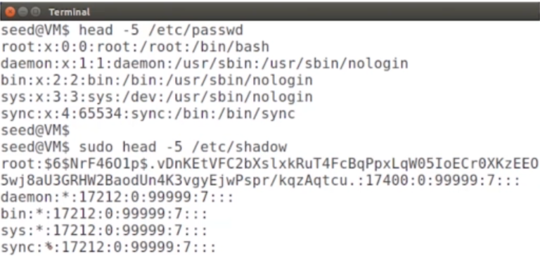
Shadow Password Scheme
For added security, password hashes are typically not stored in /etc/passwd, but in a separate file /etc/shadow, which is only readable by privileged users, e.g., root.
/etc/passwd: row format “User Name : x : User ID : Group ID : Home Dir : Shell”
2nd entry is “x”, indicating that the password hash is stored elsewhere.
/etc/shadow: 2nd entry in /etc/shadow is either password hash for the User Name, or *, indicating that this user has no password.
Command “sudo head -5 /etc/shadow”: run as root, and display the top 5 lines in /etc/shadow.
Notes:
Salt scheme is still important: for multi-server installations which use centralized password management systems to push password hashes to multiple systems, the root account on each individual system may be treated as less trusted than the administrators of the centralized password system, so the shadow password file may be exposed to attackers
Helps mitigate password attacks
A widely used password security technique is the use of hashed passwords and
a salt value. This scheme is found on virtually all UNIX variants as well as on
a number of other operating systems. The following procedure is employed
(Figure 3.2a). To load a new password into the system, the user selects or is
assigned a password. This password is combined with a fixed-length salt
value [MORR79]. In older implementations, this value is related to the time
at which the password is assigned to the user. Newer implementations use a
pseudorandom or random number. The password and salt serve as inputs to a
hashing algorithm to produce a fixed-length hash code. The hash algorithm is
designed to be slow to execute in order to thwart attacks. The hashed password
is then stored, together with a plaintext copy of the salt, in the password file for
the corresponding user ID. The hashed password method has been shown to be
secure against a variety of cryptanalytic attacks [WAGN00].
When a user attempts to log on to a UNIX system, the user provides an ID
and a password (Figure 3.2b). The operating system uses the ID to index into the
password file and retrieve the plaintext salt and the encrypted password. The salt
and user-supplied password are used as input to the encryption routine. If the result
matches the stored value, the password is accepted.
The salt serves three purposes:
• It prevents duplicate passwords from being visible in the password file. Even if
two users choose the same password, those passwords will be assigned different
salt values. Hence, the hashed passwords of the two users will differ.
• It greatly increases the difficulty of offline dictionary attacks. For a salt of
length b bits, the number of possible passwords is increased by a factor of 2^{b},
increasing the difficulty of guessing a password in a dictionary attack.
• It becomes nearly impossible to find out whether a person with passwords on
two or more systems has used the same password on all of them.
To see the second point, consider the way that an offline dictionary attack
would work. The attacker obtains a copy of the password file. Suppose first that
the salt is not used. The attacker’s goal is to guess a single password. To that end,
the attacker submits a large number of likely passwords to the hashing function.
If any of the guesses matches one of the hashes in the file, then the attacker
has found a password that is in the file. But faced with the UNIX scheme, the
attacker must take each guess and submit it to the hash function once for each
salt value in the dictionary file, multiplying the number of guesses that must be
checked.
There are two threats to the UNIX password scheme. First, a user can gain
access on a machine using a guest account or by some other means and then run
a password guessing program, called a password cracker, on that machine. The
attacker should be able to check many thousands of possible passwords with little
resource consumption. In addition, if an opponent is able to obtain a copy of the
password file, then a cracker program can be run on another machine at leisure. This
enables the opponent to run through millions of possible passwords in a reasonable
period.

Slide 15
Password Selection Strategies
User education
Users can be told the importance of using hard to guess passwords and can be provided with guidelines for selecting strong passwords
Computer generated passwords
Users have trouble remembering them, often used for resetting password, and user has to change it immediately.
Reactive password checking
System periodically runs its own password cracker to find guessable passwords
Complex password policy
Forcing users to pick stronger passwords
Notes:
When not constrained, many users choose a password that is too short or too easy
to guess. At the other extreme, if users are assigned passwords consisting of eight
randomly selected printable characters, password cracking is effectively impossible.
But it would be almost as impossible for most users to remember their passwords.
Fortunately, even if we limit the password universe to strings of characters that are
reasonably memorable, the size of the universe is still too large to permit practical
cracking. Our goal, then, is to eliminate guessable passwords
while allowing the user to select a password that is memorable. Four basic techniques
are in use:
Complex password policy
Forcing users to pick stronger passwords
• User education
• Computer-generated passwords
• Reactive password checking
• Complex password policy
Users can be told the importance of using hard-to-guess passwords and can
be provided with guidelines for selecting strong passwords. This user education
strategy is unlikely to succeed at most installations, particularly where there is a large
user population or a lot of turnover. Many users will simply ignore the guidelines.
Others may not be good judges of what is a strong password. For example, many
users (mistakenly) believe that reversing a word or capitalizing the last letter makes
a password unguessable.
Nonetheless, it makes sense to provide users with guidelines on the selection
of passwords. Perhaps the best approach is the following advice: A good technique
for choosing a password is to use the first letter of each word of a phrase. However,
do not pick a well-known phrase like “An apple a day keeps the doctor away”
(Aaadktda). Instead, pick something like “My dog’s first name is Rex” (MdfniR)
or “My sister Peg is 24 years old” (MsPi24yo). Studies have shown that users can
generally remember such passwords but that they are not susceptible to password
guessing attacks based on commonly used passwords.
Computer-generated passwords also have problems. If the passwords are quite
random in nature, users will not be able to remember them. Even if the password
is pronounceable, the user may have difficulty remembering it and so be tempted
to write it down. In general, computer-generated password schemes have a history
of poor acceptance by users. FIPS 181 defines one of the best-designed automated
password generators. The standard includes not only a description of the approach
but also a complete listing of the C source code of the algorithm. The algorithm
generates words by forming pronounceable syllables and concatenating them to
form a word. A random number generator produces a random stream of characters
used to construct the syllables and words.
A reactive password checking strategy is one in which the system periodically
runs its own password cracker to find guessable passwords. The system cancels
any passwords that are guessed and notifies the user. This tactic has a number
of drawbacks. First, it is resource intensive if the job is done right. Because a
determined opponent who is able to steal a password file can devote full CPU
time to the task for hours or even days, an effective reactive password checker is
at a distinct disadvantage. Furthermore, any existing passwords remain vulnerable
until the reactive password checker finds them. A good example is the openware
Jack the Ripper password cracker (openwall.com/john/pro/), which works on a
variety of operating systems.
A promising approach to improved password security is a complex password
policy , or proactive password checker . In this scheme, a user is allowed to select his
or her own password. However, at the time of selection, the system checks to see if
the password is allowable and, if not, rejects it. Such checkers are based on the philosophy
that, with sufficient guidance from the system, users can select memorable
passwords from a fairly large password space that are not likely to be guessed in a
dictionary attack.
The trick with a proactive password checker is to strike a balance between
user acceptability and strength. If the system rejects too many passwords, users will
complain that it is too hard to select a password. If the system uses some simple
algorithm to define what is acceptable, this provides guidance to password crackers
to refine their guessing technique. In the remainder of this subsection, we look at
possible approaches to proactive password checking.

Slide 16
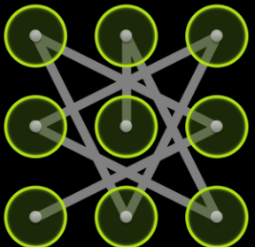
Unlock Patterns as Passwords
Attackers can exploit user biases in unlock patterns
There is a bias in starting near the top left of the screen
The ease of moving from current to next point introduces bias
Would anyone choose such a secure, but complex pattern?

Slide 17
Outline
Introduction
Password-based authentication
Token-based authentication
Biometric authentication
Remote user authentication

Slide 18
Magnetic Stripe Card
A magnetic stripe can store only a simple security code, which can be read (and reprogrammed/cloned) by an inexpensive card reader.
“2017年5月1日起，银行将全面关闭芯片磁条复合卡的磁条交易。”
From 百度百科
Used in low-impact use cases, e.g., hotel room key
Notes:
Memory cards can store but not process data. The most common such card is the
bank card with a magnetic stripe on the back. A magnetic stripe can store only a
simple security code, which can be read (and unfortunately reprogrammed) by
an inexpensive card reader. There are also memory cards that include an internal
electronic memory.
Memory cards can be used alone for physical access, such as a hotel room. For
computer user authentication, such cards are typically used with some form of password
or personal identification number (PIN). A typical application is an automatic
teller machine (ATM). The memory card, when combined with a PIN or password, provides significantly
greater security than a password alone. An adversary must gain physical
possession of the card (or be able to duplicate it) plus must gain knowledge of the
PIN. Among the potential drawbacks are the following [NIST95]:
• Requires special reader: This increases the cost of using the token and creates
the requirement to maintain the security of the reader’s hardware and software.
• Token loss: A lost token temporarily prevents its owner from gaining system
access. Thus there is an administrative cost in replacing the lost token. In addition,
if the token is found, stolen, or forged, then an adversary now need only
determine the PIN to gain unauthorized access.
• User dissatisfaction: Although users may have no difficulty in accepting the
use of a memory card for ATM access, its use for computer access may be
deemed inconvenient.

Slide 19
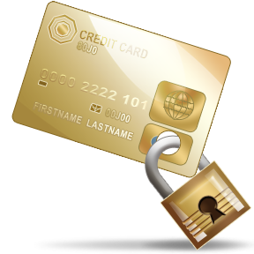
Smart Cards
Contains an embedded microprocessor with memory; cannot be easily cloned like a magnetic stripe card
Interface:
Contact vs. contactless
Challenge-response authentication protocol:
Computer system generates a challenge, e.g., a nonce; the smart card generates a response, e.g., by encrypting the nonce with its private key.
Notes:
Static: token authenticates the user to the computer.
Dynamic password generator: the token generates a unique password periodically (e.g., every minute).
For user authentication the most important category of smart token is the
smart card, which has the appearance of a credit card, has an electronic interface,
and may use any of the type of protocols just described. The remainder of this
section discusses smart cards.
A smart card contains within it an entire microprocessor, including processor,
memory, and I/O ports. Some versions incorporate a special co-processing circuit for
cryptographic operation to speed the task of encoding and decoding messages or generating
digital signatures to validate the information transferred. In some cards, the
I/O ports are directly accessible by a compatible reader by means of exposed
electrical contacts. Other cards rely instead on an embedded antenna for wireless communication
with the reader.
A typical smart card includes three types of memory. Read-only memory
(ROM) stores data that does not change during the card’s life, such as the card
number and the cardholder’s name. Electrically erasable programmable ROM
(EEPROM) holds application data and programs, such as the protocols that the
card can execute. It also holds data that may vary with time. For example, in a
telephone card, the EEPROM holds the talk time remaining. Random access
memory (RAM) holds temporary data generated when applications are executed.
A wide variety of devices qualify as smart tokens. These can be categorized along
three dimensions that are not mutually exclusive:
• Physical characteristics: Smart tokens include an embedded microprocessor.
A smart token that looks like a bank card is called a smart card. Other smart
tokens can look like calculators, keys, or other small portable objects.
• Interface: Manual interfaces include a keypad and display for human/token
interaction. Smart tokens with an electronic interface communicate with a
compatible reader/writer.
• Authentication protocol: The purpose of a smart token is to provide a means
for user authentication. We can classify the authentication protocols used with
smart tokens into three categories:
— Static: With a static protocol, the user authenticates himself or herself
to the token and then the token authenticates the user to the computer.
The latter half of this protocol is similar to the operation of a memory
token.
— Dynamic password generator: In this case, the token generates a unique
password periodically (e.g., every minute). This password is then entered
into the computer system for authentication, either manually by the user or
electronically via the token. The token and the computer system must be
initialized and kept synchronized so that the computer knows the password
that is current for this token.
— Challenge-response: In this case, the computer system generates a challenge,
such as a random string of numbers. The smart token generates a response
based on the challenge. For example, public-key cryptography could be used
and the token could encrypt the challenge string with the token’s private key.

Slide 20
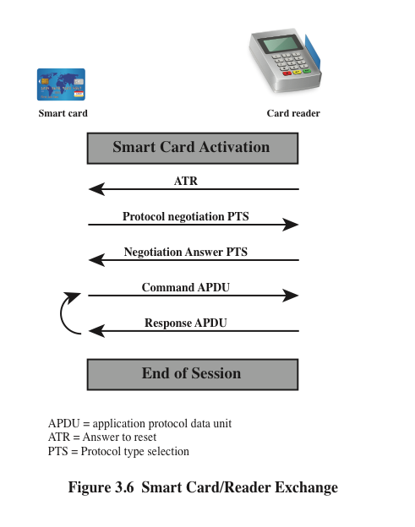
Smart Card/Reader Exchange
Figure illustrates the typical interaction between a smart card and a card reader. When the card is inserted into the reader:
Card sends a reset to the reader
Reader sends Answer To Reset (ATR) message to card, which defines the parameters and protocols that the card can use and the functions it can perform.
Protocol Type Selection (PTS) messages are used to negotiate a protocol
Reader and card can now exchange data (APDU) to perform the desired function.
Notes:
The card’s
PTS response confirms the protocols and parameters to be used.

Slide 21
Outline
Introduction
Password-based authentication
Token-based authentication
Biometric authentication
Remote user authentication

Slide 22
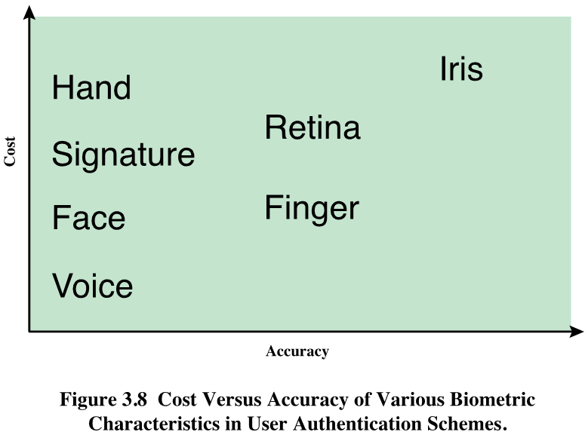
Biometric Authentication
Authentication based on unique physical characteristics
Face, fingerprints, retina, voice…
Face recognition today is very accurate (Fig. 3.8 is out of date)
Possible attacks
Copied fingerprints, fake face, fake voice…
Notes:
A biometric authentication system attempts to authenticate an individual based on
his or her unique physical characteristics. These include static characteristics, such
as fingerprints, hand geometry, facial characteristics, and retinal and iris patterns;
and dynamic characteristics, such as voiceprint and signature. In essence, biometrics
is based on pattern recognition. Compared to passwords and tokens, biometric
authentication is both technically complex and expensive. While it is used in a
number of specific applications, biometrics has yet to mature as a standard tool for
user authentication to computer systems.
A number of different types of physical characteristics are either in use or under
study for user authentication. The most common are the following:
• Facial characteristics: Facial characteristics are the most common means
of human-to-human identification; thus it is natural to consider them for
identification by computer. The most common approach is to define characteristics
based on relative location and shape of key facial features, such as
eyes, eyebrows, nose, lips, and chin shape. An alternative approach is to use an
infrared camera to produce a face thermogram that correlates with the underlying
vascular system in the human face.
• Fingerprints: Fingerprints have been used as a means of identification for
centuries, and the process has been systematized and automated particularly
for law enforcement purposes. A fingerprint is the pattern of ridges and
furrows on the surface of the fingertip. Fingerprints are believed to be unique
across the entire human population. In practice, automated fingerprint recognition
and matching system extract a number of features from the fingerprint
for storage as a numerical surrogate for the full fingerprint pattern.
• Hand geometry: Hand geometry systems identify features of the hand,
including shape, and lengths and widths of fingers.
• Retinal pattern: The pattern formed by veins beneath the retinal surface is
unique and therefore suitable for identification. A retinal biometric system
obtains a digital image of the retinal pattern by projecting a low-intensity
beam of visual or infrared light into the eye.
• Iris: Another unique physical characteristic is the detailed structure of the iris.
• Signature: Each individual has a unique style of handwriting and this is
reflected especially in the signature, which is typically a frequently written
sequence. However, multiple signature samples from a single individual will
not be identical. This complicates the task of developing a computer representation
of the signature that can be matched to future samples.
• Voice: Whereas the signature style of an individual reflects not only the unique
physical attributes of the writer but also the writing habit that has developed,
voice patterns are more closely tied to the physical and anatomical characteristics
of the speaker. Nevertheless, there is still a variation from sample to sample over
time from the same speaker, complicating the biometric recognition task.

Slide 23
Enrollment followed by either
Verification: the user enters a name (PIN), and uses a biometric sensor. The system identifies the user through name (PIN), and compares her biometric feature to the template stored for this user.
Identification: the user uses a biometric sensor, but does not enter name (PIN). The system compares her biometric feature to the set of stored templates for all users, and if there is a match, then this user is authenticated.

Slide 24
Notes:
In any biometric scheme, some physical characteristic of the individual is mapped into a
digital representation. For each individual, a single digital representation, or template, is
stored in the computer. When the user is to be authenticated, the system
compares the stored template to the presented template. Given the complexities of physical characteristics,
we cannot expect that there will be an exact match between the two templates.
Rather, the system uses an algorithm to generate a matching score (typically a single
number) that quantifies the similarity between the input and the stored template. To
proceed with the discussion, we define the following terms. The false match rate is the
frequency with which biometric samples from different sources are erroneously assessed
to be from the same source. The false nonmatch rate is the frequency with which samples
from the same source are erroneously assessed to be from different sources.
Figure 3.9 illustrates the dilemma posed to the system. If a single user is tested
by the system numerous times, the matching score s will vary, with a probability
density function typically forming a bell curve, as shown. For example, in the case of
a fingerprint, results may vary due to sensor noise; changes in the print due to swelling,
dryness, and so on; finger placement; and so on. On average, any other individual
should have a much lower matching score but again will exhibit a bell-shaped probability
density function. The difficulty is that the range of matching scores produced
by two individuals, one genuine and one an imposter, compared to a given reference
template, are likely to overlap. In Figure 3.9 a threshold value is selected thus that if
the presented value s ≥ t a match is assumed, and for s <t, a mismatch is assumed.
The shaded part to the right of t indicates a range of values for which a false match is
possible, and the shaded part to the left indicates a range of values for which a false
nonmatch is possible. The area of each shaded part represents the probability of a
false match or nonmatch, respectively. By moving the threshold, left or right, the
probabilities can be altered, but note that a decrease in false match rate necessarily
results in an increase in false nonmatch rate, and vice versa.

Slide 25
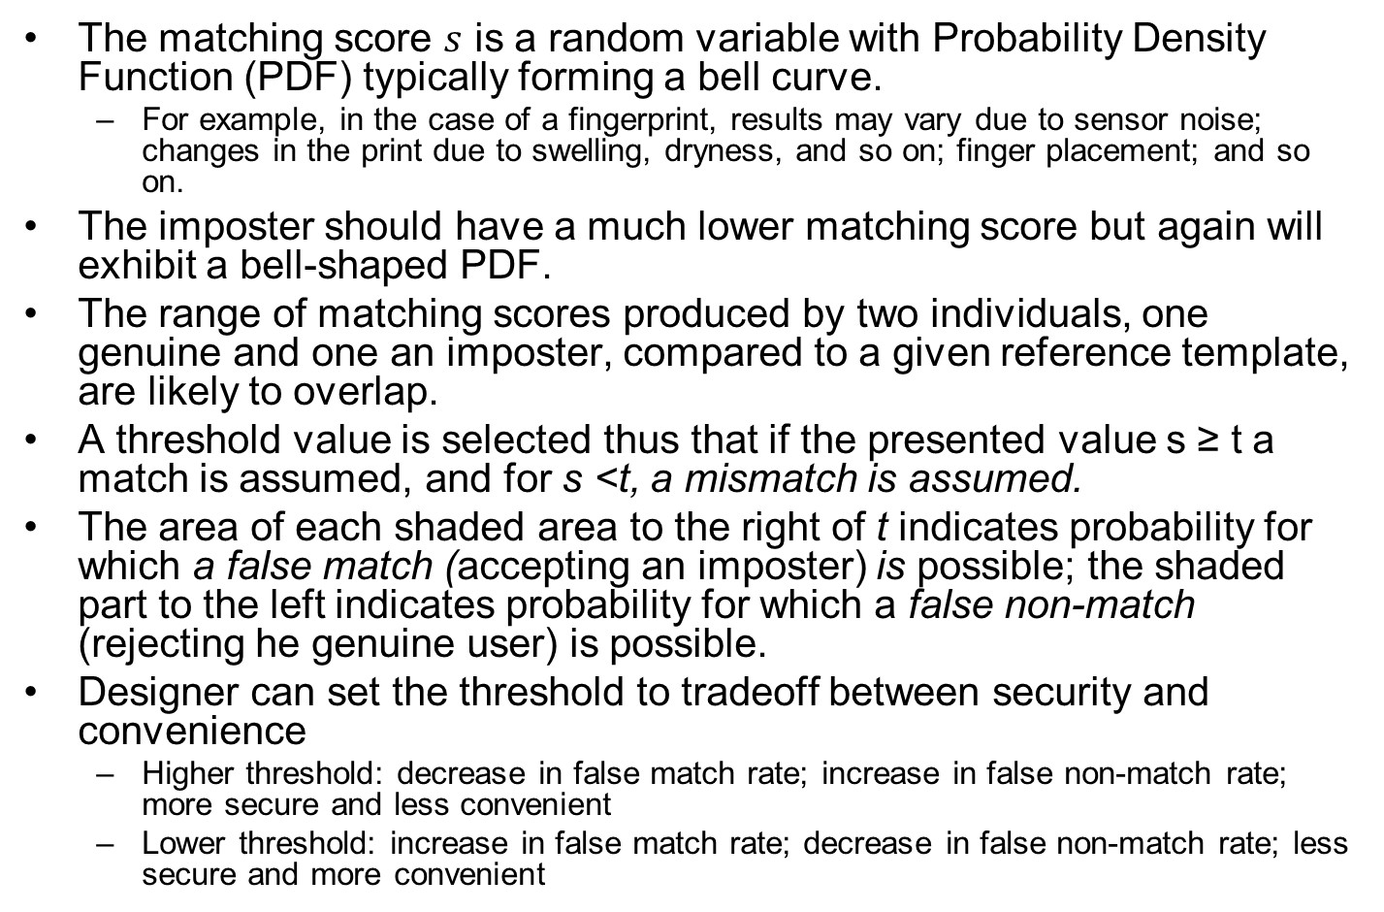
Fig. 3.10
The matching score $s$ is a random variable with Probability Density Function (PDF) typically forming a bell curve.
For example, in the case of a fingerprint, results may vary due to sensor noise; changes in the print due to swelling, dryness, and so on; finger placement; and so on.
The imposter should have a much lower matching score but again will exhibit a bell-shaped PDF.
The range of matching scores produced by two individuals, one genuine and one an imposter, compared to a given reference template, are likely to overlap.
A threshold value is selected thus that if the presented value s ≥ t a match is assumed, and for s <t, a mismatch is assumed.
The area of each shaded area to the right of t indicates probability for which a false match (accepting an imposter) is possible; the shaded part to the left indicates probability for which a false non-match (rejecting he genuine user) is possible.
Designer can set the threshold to tradeoff between security and convenience
Higher threshold: decrease in false match rate; increase in false non-match rate; more secure and less convenient
Lower threshold: increase in false match rate; decrease in false non-match rate; less secure and more convenient

Slide 27
Outline
Introduction
Password-based authentication
Token-based authentication
Biometric authentication
Remote user authentication

Slide 28
Remote User Authentication
Authentication over the Internet
Security threats include:
Eavesdropping, capturing a password, replaying an authentication sequence that has been observed
Generally rely on some form of a challenge-response protocol to counter threats
Notes:
The simplest form of user authentication is local authentication, in which a user
attempts to access a system that is locally present, such as a stand-alone office PC or
an ATM machine. The more complex case is that of remote user authentication,
which takes place over the Internet, a network, or a communications link. Remote
user authentication raises additional security threats, such as an eavesdropper being
able to capture a password, or an adversary replaying an authentication sequence
that has been observed.
To counter threats to remote user authentication, systems generally rely on some
form of challenge-response protocol. In this section, we present the basic elements of
such protocols for each of the types of authenticators discussed in this chapter.

Slide 29
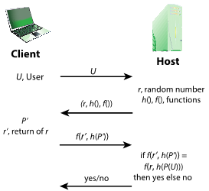
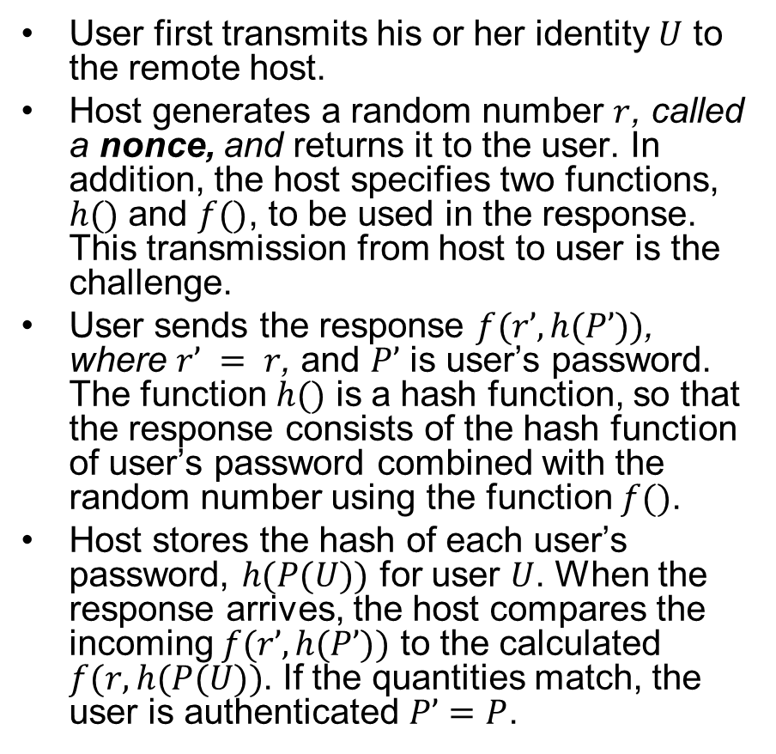
Challenge-Response Protocol for Password Authentication
User first transmits his or her identity $U$ to the remote host.
Host generates a random number $r$, called a nonce, and returns it to the user. In addition, the host specifies two functions, $h()$ and $f()$, to be used in the response. This transmission from host to user is the challenge.
User sends the response $f(r’, h(P’))$, where $r’ = r$, and $P’$ is user’s password. The function $h()$ is a hash function, so that the response consists of the hash function of user’s password combined with the random number using the function $f()$.
Host stores the hash of each user’s password, $h(P(U))$ for user $U$. When the response arrives, the host compares the incoming $f(r’, h(P’))$ to the calculated $f(r, h(P(U))$. If the quantities match, the user is authenticated $P’=P$.
Notes:
Other C-R protocols exist for token-based or biometric authentication.

Slide 30
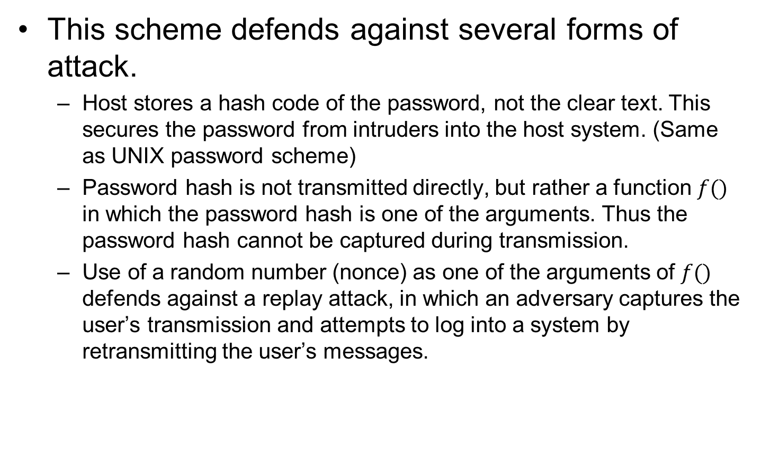
Benefits of Challenge-Response Protocol
This scheme defends against several forms of attack.
Host stores a hash code of the password, not the clear text. This secures the password from intruders into the host system. (Same as UNIX password scheme)
Password hash is not transmitted directly, but rather a function $f()$ in which the password hash is one of the arguments. Thus the password hash cannot be captured during transmission.
Use of a random number (nonce) as one of the arguments of $f()$ defends against a replay attack, in which an adversary captures the user’s transmission and attempts to log into a system by retransmitting the user’s messages.

Slide 31
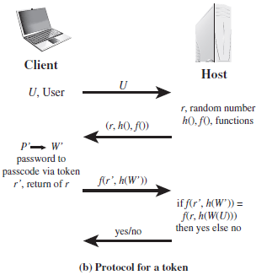
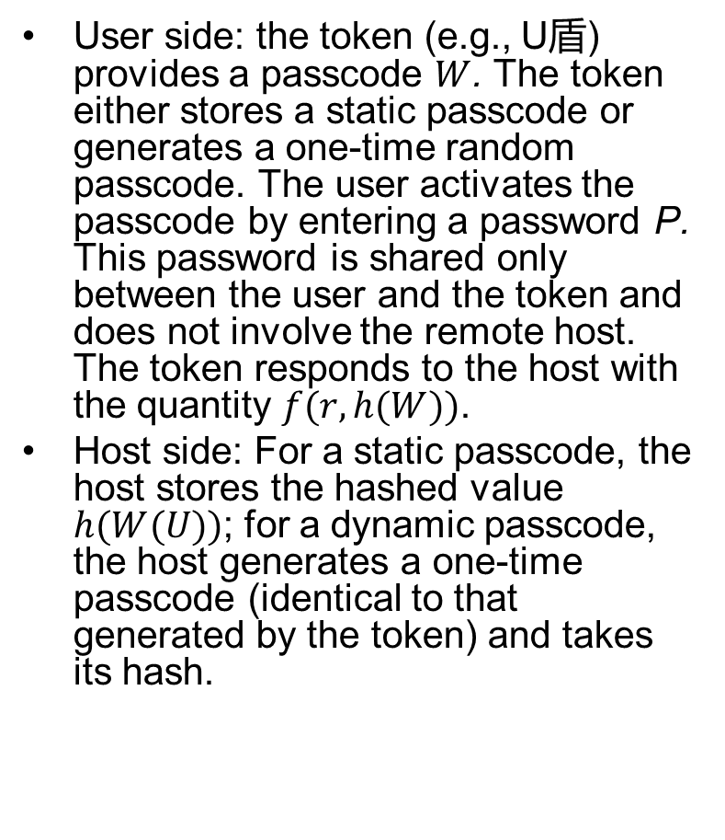
Other Challenge-Response Protocols: Token
User side: the token (e.g., U盾) provides a passcode $W$. The token either stores a static passcode or generates a one-time random passcode. The user activates the passcode by entering a password P. This password is shared only between the user and the token and does not involve the remote host. The token responds to the host with the quantity $f(r, h(W))$.
Host side: For a static passcode, the host stores the hashed value $h(W(U))$; for a dynamic passcode, the host generates a one-time passcode (identical to that generated by the token) and takes its hash.

Slide 32
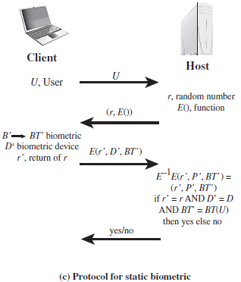
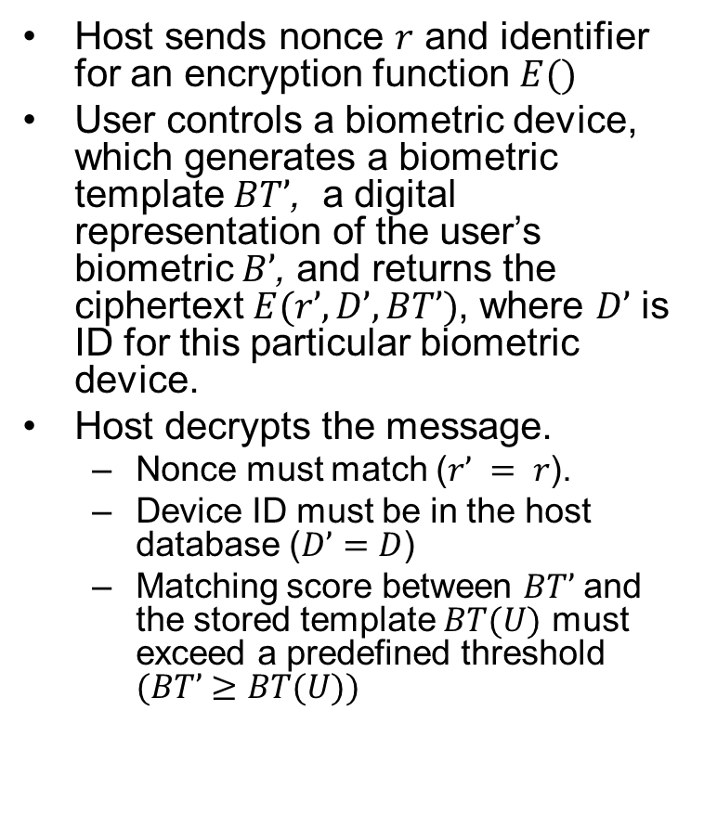

Other Challenge-Response Protocols: Static Biometric
Host sends nonce $r$ and identifier for an encryption function $E()$
User controls a biometric device, which generates a biometric template $BT’$, a digital representation of the user’s biometric $B’$, and returns the ciphertext $E(r’, D’, BT’)$, where $D’$ is ID for this particular biometric device.
Host decrypts the message.
Nonce must match ($r’ = r$).
Device ID must be in the host database ($D’=D$)
Matching score between $BT’$ and the stored template $BT(U)$ must exceed a predefined threshold $(BT’≥BT(U))$
Typo: $(BT’≥BT(U))$

Slide 33
Authentication Security Issues
Eavesdropping
Adversary attempts to learn the password by, say, looking over the shoulder of victim, or sniffing network packets
Host Attacks
Directed at the user file at the host where passwords, token passcodes, or biometric templates are stored
Replay
Adversary repeats a previously captured user response
Client Attacks
Adversary attempts to achieve user authentication without access to the remote host or the intervening communications path
Trojan Horse
An application or physical device masquerades as an authentic application or device for the purpose of capturing a user password, passcode, or biometric
Denial-of-Service
Attempts to disable a user authentication service by trying multiple authentication attempts, e.g., the account may be locked after N unsuccessful attempts.
Notes:
Client attacks are those in which an adversary attempts to achieve user
authentication without access to the remote host or to the intervening communications
path. The adversary attempts to masquerade as a legitimate user. For a password-
based system, the adversary may attempt to guess the likely user password.
Multiple guesses may be made. At the extreme, the adversary sequences through
all possible passwords in an exhaustive attempt to succeed. One way to thwart such
an attack is to select a password that is both lengthy and unpredictable. In effect,
such a password has large entropy; that is, many bits are required to represent the
password. Another countermeasure is to limit the number of attempts that can be
made in a given time period from a given source.
A token can generate a high-entropy passcode from a low-entropy PIN or password,
thwarting exhaustive searches. The adversary may be able to guess or acquire
the PIN or password but must additionally acquire the physical token to succeed.
Host attacks are directed at the user file at the host where passwords, token
passcodes, or biometric templates are stored. Section 3.2 discusses the security
considerations with respect to passwords. For tokens, there is the additional
defense of using one-time passcodes, so that passcodes are not stored in a host
passcode file. Biometric features of a user are difficult to secure because they are
physical features of the user. For a static feature, biometric device authentication
adds a measure of protection. For a dynamic feature, a challenge-response
protocol enhances security.
Eavesdropping in the context of passwords refers to an adversary’s attempt to
learn the password by observing the user, finding a written copy of the password,
or some similar attack that involves the physical proximity of user and adversary.
Another form of eavesdropping is keystroke logging (keylogging), in which malicious
hardware or software is installed so that the attacker can capture the user’s keystrokes
for later analysis. A system that relies on multiple factors (e.g., password plus token or
password plus biometric) is resistant to this type of attack. For a token, an analogous
threat is theft of the token or physical copying of the token. Again, a multifactor
protocol resists this type of attack better than a pure token protocol. The analogous
threat for a biometric protocol is copying or imitating the biometric
parameter so as to generate the desired template. Dynamic biometrics are less susceptible
to such attacks. For static biometrics, device authentication is a useful countermeasure.
Replay attacks involve an adversary repeating a previously captured
user response. The most common countermeasure to such attacks is the challenge-response
protocol.
In a Trojan horse attack, an application or physical device masquerades as
an authentic application or device for the purpose of capturing a user password,
passcode, or biometric. The adversary can then use the captured information to
masquerade as a legitimate user. A simple example of this is a rogue bank machine
used to capture user ID/password combinations.
A denial-of-service attack attempts to disable a user authentication service by
flooding the service with numerous authentication attempts. A more selective attack
denies service to a specific user by attempting logon until the threshold is reached
that causes lockout to this user because of too many logon attempts. A multifactor
authentication protocol that includes a token thwarts this attack, because the
adversary must first acquire the token.

